Slide 1
Intelligent API for Automated Profile Generation and Job Market Insights
Fall 24 CSCE 689 Programming Large Language Models
Course Project
Made By: Omar Khater

Slide 2
Introduction

Slide 3
Problem Statement
The client aims to develop a social media app to connect creative professionals with opportunities. Think about this platform as LinkedIn, Indeed, or Upwork combined with Instagram. Similar existing tools are Behance.
Many creative professionals struggle to create compelling profiles, which can reduce their visibility and job opportunities.
In the current app implementation, they need to fill many text fields such as an elevator pitch and projects descriptions among others
This is potentially a time-consuming process. Also, they need to be aware of the current demand on the job market so that they add more desired keywords to be shown on search results

Slide 4
Project Goals

Slide 5
Proposed Objectives
Develop an API that generates professional and engaging profile descriptions based on given context (e.g., other profile elements) and current market demands, utilizing pre trained LLMs. Special attention will be given to the prompt engineering techniques used in this process as well as handling existing context (e.g., user projects, images, trending keywords, ...etc.)
Adhere to Test Driven Development (TDD) and Software Development Life Cycle (SDLC) best practices to ensure a robust, maintainable API.

Slide 6
Methodology

Slide 7
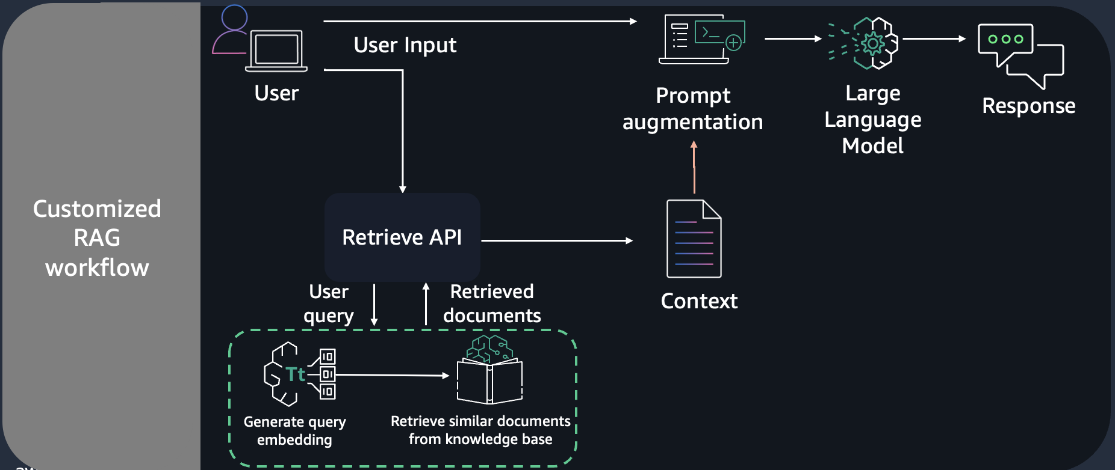
Customized RAG workflow
AWS Workshops. Amazon bedrock workshop, 2024. Accessed: 2024-12-05.

Slide 8
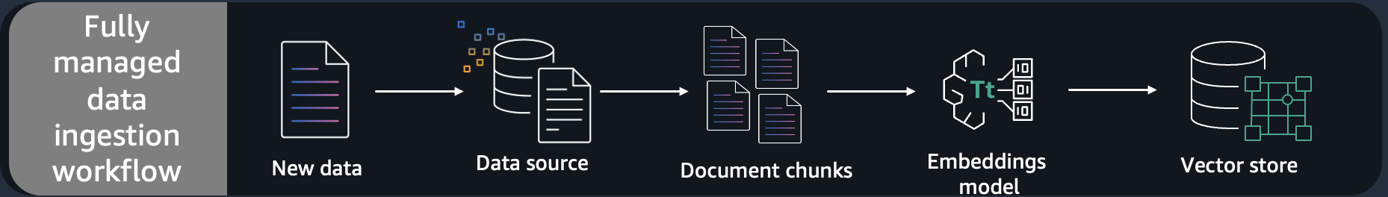
RAG Data Ingestion
AWS Workshops. Amazon bedrock workshop, 2024. Accessed: 2024-12-05.

Slide 9
Data Collection
‘build_job_skills_datasets.py‘:
fetches trending skills for job titles by scraping online sources. The data is organized into a structured data set, associating each job title with its relevant skills
• ‘build_job_skills_database.py‘:
converts this dataset into a vector database using embeddings generated by the Ollama model. The database allows for similarity-based retrieval by leveraging vector representations of the user input (e.g., profession, experience level)

Slide 10
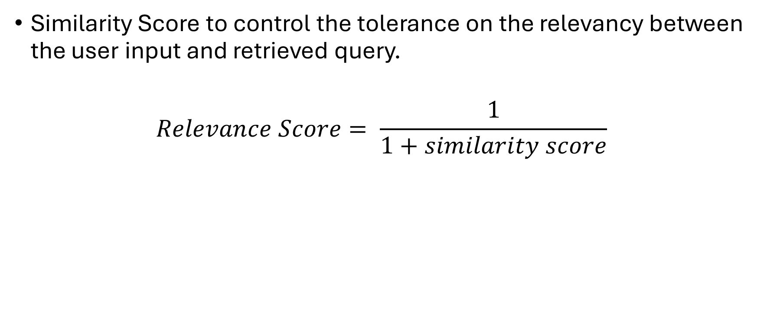
Design Choices
Similarity Score to control the tolerance on the relevancy between the user input and retrieved query.
$$Relevance Score= \frac{1}{1+similarity score}$$
Vector DB
User Input
Keywords
Each keyword has similarity score

Slide 11
Evaluation

Slide 12
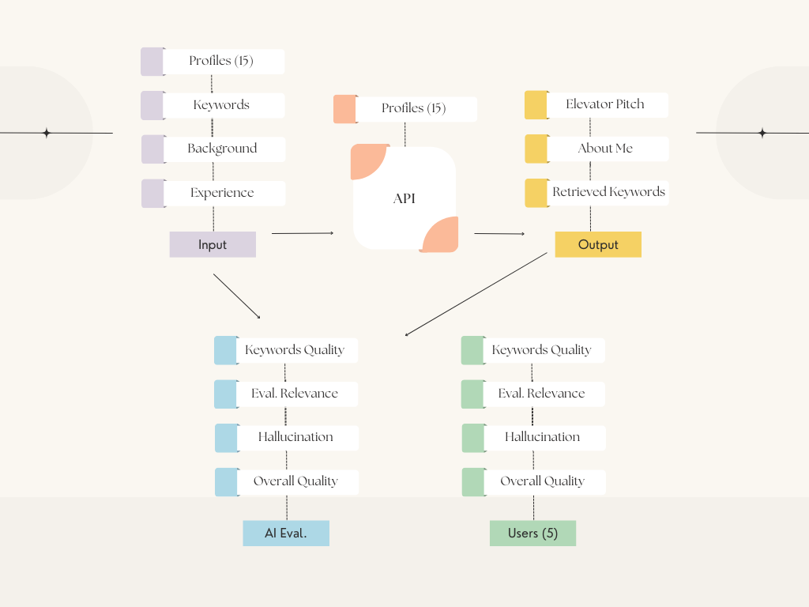
Flowchart

Slide 13
Demo 1
Simple UI Usage

Slide 14
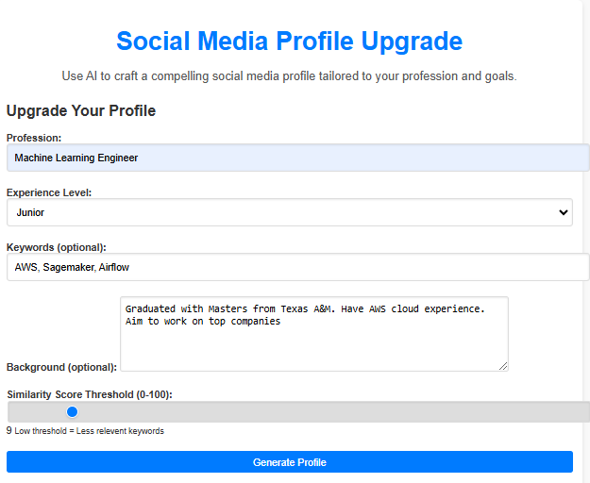
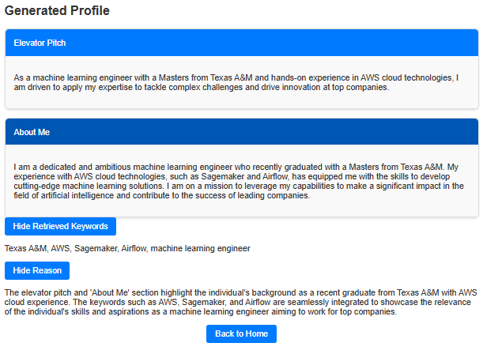
Sample UI Screenshots

Slide 15
Demo 2
Integration with NXTFolio

Slide 16
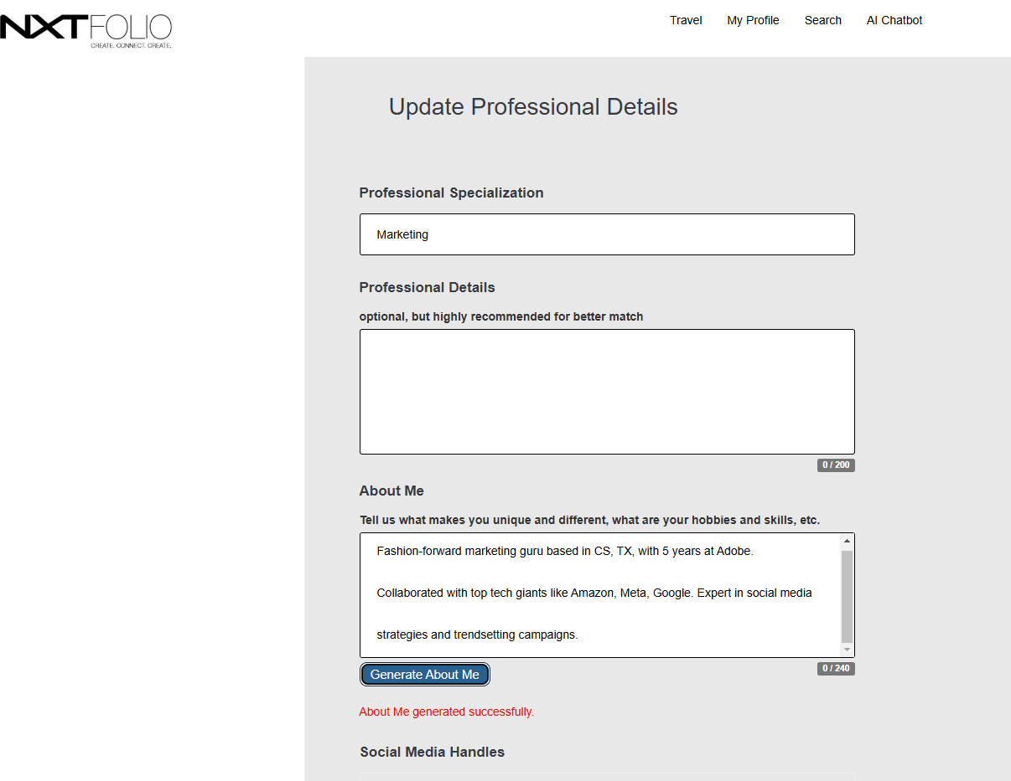
Temporary Deployment:
https://bhill24nxtfolio-a255640ed261.herokuapp.com/
Permanent Deployment:
https://nxtfolio.herokuapp.com/
NXTFolio Documentation:
GitHub:
https://github.com/FashioNXT/NXTFolio
Presentation:
https://www.youtube.com/watch?v=fwQdqHMS_KU

Slide 17
Conclusions

Slide 18
What We Have done!
Successful API development & Evaluation
Successful output delivery
Special attention to LLM techniques such as RAG design, prompt engineering has been investigated

Slide 19
Next Steps

Slide 20
Future Directions
AI based resume generator
Multi-modal contextual advanced API

Slide 21

Thank You!

